Slide 1
PCOS – An Algorithm for Management of Infertility
SIG Endocrinology 2019
Chairperson – Madhuri Patil

Slide 2
Prevalence
30 % of all infertility is associated with anovulation, & 85-90% of these attributed to PCOS
21 – 59 % of women in reproductive age demonstrate USG picture of polycystic ovaries
About 30 - 50 % have clinical or biochemical signs of Anovulation and androgen excess
Higher incidence in south Asian population (50%)
(Dunaif 1995 , Norman etal 2002)

Slide 3
PCOS: Complex Clinical Syndrome
Genetics
Multigene environmental interaction
Environment and Lifestyle
Hormonal Changes
Obesity exacerbates hormonal changes
Androgens
Insulin
Ovarian follicles
Anovulation
Estrogens
Type II Diabetes
Metabolic Syndrome
Hirsutism and Acne
Menstrual disturbances Sub-fertility
Cardiovascular risk
Hypertension
Psychosocial issues: body image, self esteem, depression and anxiety
Teede et al BMC Medicine 2010, Norman et al Lancet 2007, Teede et al MJA 2011

Slide 4
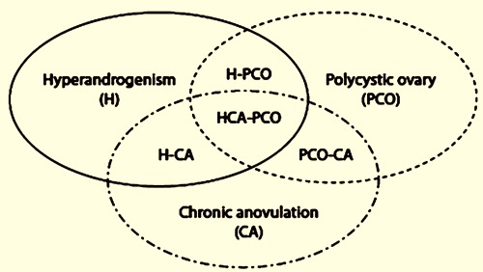
Criteria for Diagnosis of PCOS
PCOS definition NIH criteria 1990
Both of the following manifestations
1.Clinical and/or
biochemical signs of hyperandrogenism
2. Oligo- or chronic anovulation
Rotterdam criteria 2003 (ESHRE/ASRM)
Two of the following three manifestations:
1.Irregular or absent ovulation
2.Hyperandrogenism (clinical and/or biochemical)
3. polycystic ovarian morphology on USG
AE-PCOS Criteria 2006
Patient demonstrates both:
1.Hirsutism and/or
Hyperandrogenemia (clinical or biochemical)
2. Oligo-anovulation and/or polycystic ovarian morphology
Exclude other etiologies of androgen excess

Slide 5
Etiologies of androgen excess
Congenital Adrenal Hyperplasia (CAH)
Cushing's Syndrome
Androgen producing tumor-ovary or adrenal
Exogenous sex steroids
Simple Obesity
Severely insulin resistant states
Other menstrual disorders

Slide 6
Phenotypes of PCOS: Based on Rotterdam Guidelines and NIH workshop 2012 statement
PHENOTYPE A
Hyperandrogenism
Chronic Anovulation
Polycystic Ovaries (Classic)
PHENOTYPE C
Hyperandrogenism
Polycystic Ovaries
Ovulatory Cycles (Ovulatory)
PHENOTYPE D
Chronic Anovulation Polycystic Ovaries
No Clinical Or Biochemical Signs Of Androgen Excess
(Normo-androgenic)
PHENOTYPE B
Hyperandrogenism,
Chronic Anovulation
Normal Ovaries
(Classic, normal ovaries)

Slide 7
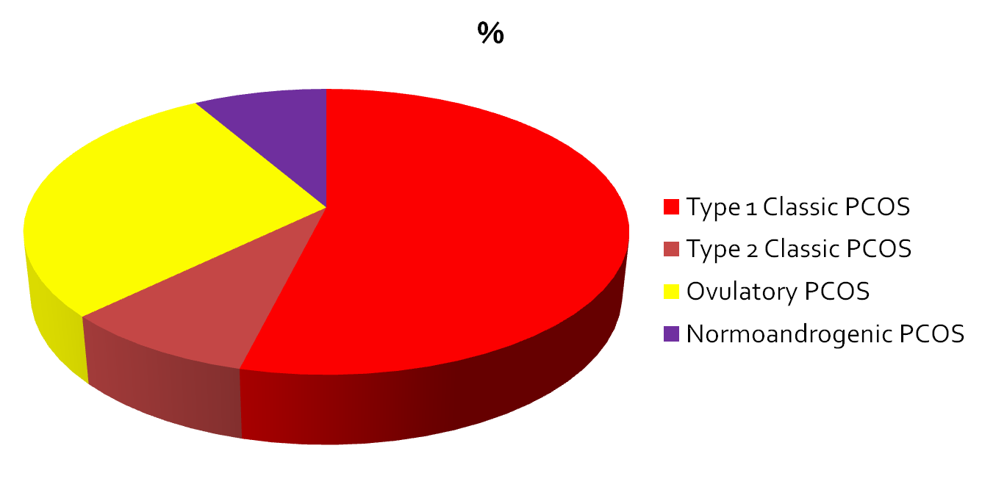
Characters of
PCOS Phenotype
 | Androgen levels | LH levels | Ovarian size | AMH levels | Body weight | Insulin resistance
PHENOTYPE A | Increased | Increased | Increased | Increased | Increased | Increased
PHENOTYPE B | Increased | Moderately increased | Normal | Mild increase | Increased | Increased
PHENOTYPE C | Moderately Increased | Normal | Moderately increased | Mild increase | Moderately increased | Moderately increased
PHENOTYPE D | Mild increase | Normal | Moderately increased | Normal | Normal | Normal

Slide 8
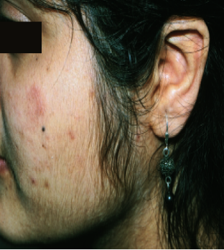
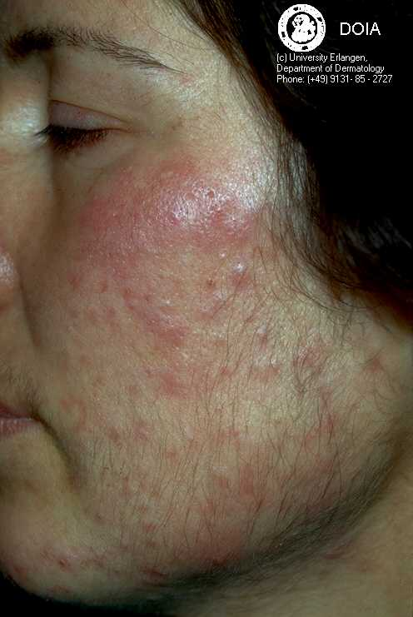
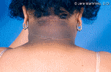

Clinical Manifestations of PCOS
Hirsutism
Acne
Amenorrhea/Oligomenorrhea
Infertility
Early pregnancy loss
Metabolic aspects:
    Obesity
    Insulin resistance
    Type 2 diabetes (10% by age 40s)
    Cardiovascular disease
upper limit is 80 cm

Slide 9
Recommendations for Defining Irregular Cycles
Category | Recommendation | Grade
CCR | When irregular menstrual cycles are present a diagnosis of PCOS should be considered and assessed according to the guidelines ● normal in the first year post menarche as part of the pubertal transition ● > 1 to < 3 years post menarche: < 21 or > 45 days ● > 3 years post menarche to perimenopause: < 21 or > 35 days or < 8 cycles per year ● > 1 year post menarche > 90 days for any one cycle ● Primary amenorrhea by age 15 or > 3 years post thelarche (breast development) | ❖❖❖❖
CCR | In an adolescent with irregular menstrual cycles, the value and optimal timing of assessment and diagnosis of PCOS should be discussed with the patient, taking into account diagnostic challenges at this life stage and psychosocial and cultural factors | ❖❖❖❖
CPP | For adolescents who have features of PCOS but do not meet diagnostic criteria, an “increased risk” could be considered and reassessment advised at or before full reproductive maturity, 8 years post menarche
CPP | Ovulatory dysfunction can still occur with regular cycles and if anovulation needs to be confirmed serum progesterone levels can be measured
Teede et al Human Reproduction 2018

Slide 10
Diagnosis – Clinical Hyperandrogenism
Hirsuitism
Modified Ferriman Gallwey (mFG) score with a level >/-4-6, depending on ethnicity.
Alopecia
Ludwig visual score
Acne
No universally accepted visual assessments for evaluation
In Indian women >/- 7
Male type of alopecia

Slide 11
Diagnosis: Biochemical Hyperandrogenism
Elevated Testosterone
Calculated free testosterone
Calculated bioavailable testosterone
Androstenedione
DHEAS
Limited value
17-hydrxy progesterone
21 hydroxylase deficiency
Late onset congenital adrenal hyperplasia
Free androgen index
(need measurements of total tesotsrone, SHBG and serum proteins)
Ideal assay for testosterone – liquid chromatography-mass spectrometry
Adrenal source of androgens

Slide 12
Polycystic Ovarian Morphology
Transvaginal USG should be used in all sexually active women
Transvaginal ultrasonography with transducer frequency of 8 MHz: ovarian volume ≥ 10 ml and or ≥ 20 follicles of 2-9 mm diameter on either ovary
Important to exclude - corpus luteum, cyst and dominant follicles
Transvaginal ultrasonography with transducer frequency ≤ 7.5 MHz: ovarian volume ≥ 10 ml and or ≥ 12 follicles of 2-9 mm diameter on either ovary

Slide 13
Diagnosis – Other tools
AMH: still not included as a diagnostic tool, however elevated AMH is considered to be indicative of PCOM.
Prolactin and TSH: for other causes of amenorrhoea
Tests of non-diagnostic but of Prognostic Value
Glycosylated Haemoglobin / 75 gm Oral Glucose tolerance test / Fasting blood glucose
Lipid profile

Slide 14
Which tests are Essential?
Biological hyperandrogenism in PCOS is inconstant and has no specific profile so calculation of FAI should be done
Serum AMH levels should not yet be used as an alternative for the detection of PCOM or as a single test for the diagnosis of PCOS
Follicle excess is the best criteria for PCOS but threshold is highly dependent on technology used With newer technologies, it is 20...
75-g OGTT should be offered in all women with PCOS
Complete OGTT with fasting glucose in obese and with F/H type 2 diabetes
Androgen testing in suspected cases of PCOS is for differential diagnosis

Slide 15
To diagnose PCOS one must exclude other disorders
Condition | Exclude by
Pregnancy | Beta hCG
Ovarian Failure | FSH
Hypothyroidism | TSH
Hyperprolactinemia | Prolactin
CAH | 17 OH progesterone
Ovarian tumor | Total testosterone (especially if> 200 ng/dl
Adrenal tumor | DHEAS (especially if > 800 mcg/dl
Cushing’s Syndrome | Serum Cortisol
PCOS ---- Diagnosis of Exclusion

Slide 16
How does one assess PCOS?
Clinical Assessment
Menstrual cycle
Progesterone if cycles regular
Androgen Profile
Free testosterone
Free androgen index
Exclude secondary causes
Thyroid function test
Prolactin
Ovarian Morphology (Absence of HA and Irregular cycles)
Androgen excess
SHBG
FSH
17OH progesterone
Clinical history and examination
AMH not recommended
Impaired glucose tolerance
Teede et al Human Reproduction 2018

Slide 17
Management
Lifestyle management first line management
(should be implemented even in obese women with long-
standing infertility due to PCOS)
Medical management
of Anovulation
Surgical management

Slide 18
Lifestyle Management
Balanced diet with and energy deficit of 30% i.e. 1200-1500kcal/day
Tailoring changes to food preferences is necessary
No evidence to support any specific diets promoted
250 min/ week of moderate intensity exercise or 150min/ week of vigorous intensity exercise and muscle strengthening activities involving major muscles on 2 non-consecutive days per week
Minimize sedentary/screen/sitting time
Behavioral strategies: goal-setting (losing 5-10% of weight); self-goal setting; stimulus control; slow eating; adequate emotional support

Slide 19
Ovulation Induction
First line Therapy
Clomiphene citrate 100mg D3-7
Second line Therapy
Additional Therapies
Letrozole 5mg D3-7
Always monitor the first cycle (TVS)
IUI
IVF
Bariatric Surgery
Metformin in combination with CC
Laparoscopic ovarian Drilling

Slide 20
First Line Therapy
Administration of oral agents for OI requires a baseline TVS on Day 2/3 to rule out any ovarian cyst
Letrozole should be considered as the first line therapy for OI in women with PCOS (2 RCTs)
Clomiphene citrate can be used in the does of 50/100 mg for OI in women with PCOS
The cycles need to be monitored by TVS to confirm adequate follicular response and endometrial growth.

Slide 21
Second Line Therapy
Metformin:
recommended daily dose is 850mg twice a day
Should not be used alone for OI. Improves ovulation rate when used in conjunction with CC
Laparoscopic Ovarian Drilling:
In selected cases – women with lean PCOS, resistant to CC
Gonadotropins:
Gonadotrophins (rFSH/HMG) should be used in CC resistant women or with CC failure
Low dose step up protocol:
Starting dose 37.5 / 50 IU
Regular TVS monitoring
Step-up the dose with small incremental dose
every 7 days if no dominant follicle
Aim: monofollicular Ovulation
It is a common practice to perform IUI when gonadotrophins are used for OI

Slide 22
IVF – Principles in PCOS
Before Ovarian Stimulation
Review Lifestyle
During Ovarian Stimulation
Low dose stimulation with rFSH / HMG
Ovulation Trigger
HCG if risk of OHSS is minimal
Metformin to minimise risk of OHSS
Antagonist (fixed, multiple dose form day5 of stimulation)
GnRH agonist trigger if at high risk of OHSS

Slide 23
Luteal Phase Management
Day of oocyte trigger
Luteal Phase
WATCH FOR S/S of OHSS
sET or DET
Freese surplus
Standard LPS
Normal Response
Rec hCG 250 mcg
5000 u hCG
Signs of OHSS
Freeze all embryos
sET
Freeze surplus
Individualizing Ovulation Trigger
&
Luteal Phase
Rec hCG 125 or 250 mcg 3500 u hCG
Proceed to Day 5 Evaluate patient
OHSS Freeze all embryos
>18 dominant follicles
E2 > 5000 pg/ml
P4 + E2 + 1500 hCG/GnRHa on day of OR for Intense LPS
sET
Freeze surplus
GnRHa Triggering
1mg SC
Freeze all embryos
Dopamine agonist

Slide 24
Take Home Message
Genetics
Lifestyle
Critical
Hormonal Changes
Androgens
Insulin
Metformin
Diabetes
Anovulation
Hirsutism/Acne
Menstrual Disturbances
Cardiovascular disease
Lifestyle
OCP
Anti androgens
Lifestyle
Metformin
OCP
OI – CC/Letrozole/ Gonadotropin
Lifestyle
Metformin
Monitoring

